Slide 1
Welcome & Introductions

Slide 2
Co-sponsored by:
Council Member Rita Joseph
District 40, Brooklyn

Slide 3
NonProfit HelpDesk
A project of the Jewish Community Council of Greater Coney Island (JCCGCI)
www.nphd.org
Notes:
NPHD Areas of Expertise
Board Development
Business Continuity Planning
Diversity
Executive Coaching
Financial Management
Fundraising
Governance
Human Resources
Leadership Development
Organizational Reboot
Team Development
Technology
NonProfit HelpDesk (NPHD)
Building Strong Communities by Building Strong Nonprofits
The NonProfit HelpDesk (NPHD) offers services, training, and dedicated professional staff support to nonprofits, empowering them to serve their clients and communities more efficiently.
We provide essential consulting services to management and staff, as well as related trainings. Our educational trainings (workshops, seminars, and full courses) allow us to reach a broad audience at minimal cost. Financial and technology services are also available upon request.
Whether you require help in one specific area, or on multiple fronts, our professional consultants are ready to assist.
NPHD is a project of the Jewish Community Council of Greater Coney Island.

Slide 4
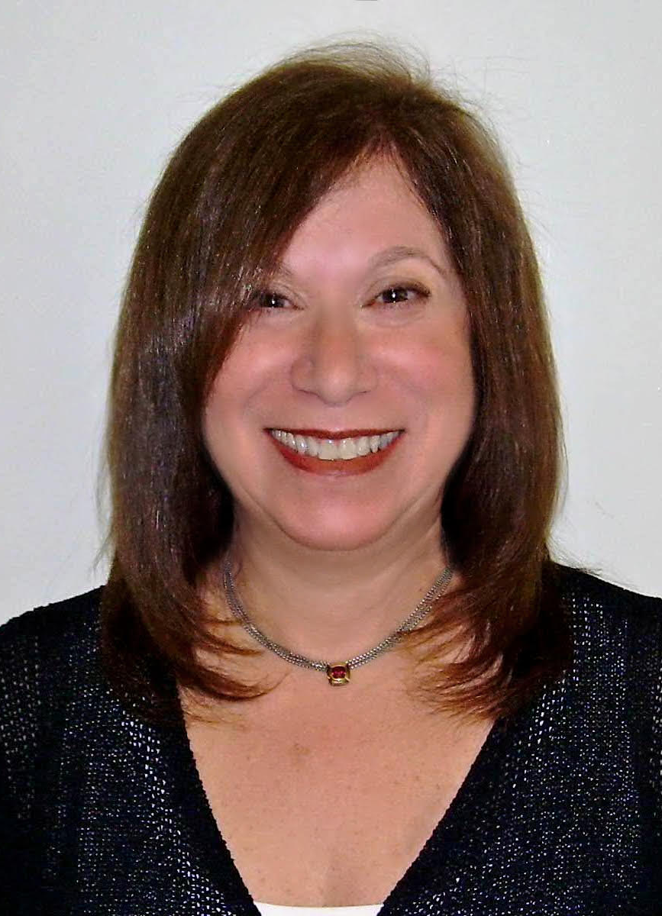
Jeri Mendelsohn, LCSW
NPHD Capacity Building Facilitator
Notes:
Representative from Laurie's office to speak and introduce the discretionary funding application process.

Slide 5
Next Steps: For organizations awarded NYC Council Discretionary Funds
Fully subsidized by generous allocations from New York City Council Members.
NPHD is a project of Jewish Community Council of Greater Coney Island (JCCGCI)
Notes:
Create a new account
Email and password
Application for every – FY2023 Discretionary Funding Application
Google NYC council
Top right hand side - Click Budget
Opens in January until February (close to two months to complete and submit)
Shouldn’t push it until the last day - - they should submit it before the last three days because the website can crash and not let you upload the application
This is a formality – every council member has a pot of money for every non-profit (not a lot of money)
Trying to figure out
Looking at the Non-profit
This is not the way to introduce yourself for the first time
Connect with the Staff members and reach out directly to the council member
It’s a work in progress
This application is a formality
Real effort is to get the council member and their staff to get to know the non-profit
Check list - of the document they need
#2 NYS Charities Bureau Registration Number – request one online (notify if the number is in process)
Annual operating budget – It’s an estimate
3. You don’t need to have – clear in HHS Enter their information and upload certain documents – they don’t need to do this
***Need to register to access the funding – not register to submit the application ***Learn what are the HHS documents they need to be qualified and registered with the system
6. No names needed – just the organization chart (fiscal point of contact)
7.
8. Only relevant for new incorporations after July 1, 2017
9. Only if the board members have a relationship with a council members

Slide 6
Housekeeping Items
To make this a productive workshop beneficial to all attendees, we ask the following:
Keep yourself muted (bottom left corner of your screen)
Update your screen name with First Name and Organization Name
If you have a question, please use the "CHAT" feature or "RAISE" your hand feature.
On the chat, include Name, position, email address and phone number
Copy of this presentation will be provided by email after the workshop. Also, this workshop will be recorded for future reference.
Be respectful to others. We are all here to learn and have a positive networking experience

Slide 7
Next Steps: For organizations awarded NYC Council Discretionary Funds
What is required for an organization to receive a contract, fulfill its requirements, and access funds!!

Slide 8
What is Discretionary Funding?
Discretionary funding is money in the City’s budget allocated to an eligible not-for-profit organization by the Council or a Member of the Council.
This helps the City Council Members address local needs within their communities.
There are specific Discretionary Funding Policies and Procedures that both Council Members and agencies need to follow.
Notes:
Discretionary funding is a duly appropriated sum of money in the City’s expense budget allocated to an eligible not-for-profit organization by the Council or a Member of the Council under section 1-02(e) of the rules of the Procurement Policy Board (PPB). PPB Rule 1-02(e) allows certain elected officials – including Council Members and Borough Presidents (but not the Mayor or City agencies) – to designate specific not-for-profit organizations to receive funding as an alternative to funding programs through competitive procurement. Unlike competitively awarded Agency contracts, awarded discretionary funds contracts are for a single fiscal year
The law allows Council Members and Borough Presidents (but not the Mayor or City agencies) – to designate nonprofit organizations to receive funding as an alternative to funding programs through competitive procurement.

Slide 9
Transparency: What is It
The NYC Council Discretionary Process is designed to ensure that NYC Funds are being used in responsible ways, for the public good.
Organizations applying for funding need to be carefully vetted and able to establish or maintain a business relationship with the City
Organizations need to demonstrate experience or capability to provide services to New York City residents.

Slide 10
CONGRATS!!
How do agencies know if they have been awarded a NYC Council Discretionary Grant?
During each year's budget process, the Council and its Members assign discretionary funds to not-for-profit organizations and agency initiatives to meet needs and fill gaps in City Agency services and local projects.
1) Your organization submitted its Grant Request by February20, 2024.
2) Your organization may have received word from the City Council Member’s office(s) awarding the grant.
3) Listed in the NYC Expense Budget, Schedule C
4) You may have received a letter from the NYC agency, i.e., DYCD, telling you that your agency was awarded a grant.

Slide 11
Discretionary Tracker
Discretionary Award Tracker
The Discretionary Tracker is a digital tool to search the status of all City Council Discretionary Awards from the past three fiscal years. The tracker is updated about every six weeks, after City Council votes on transparency resolutions. It will tell you your award, the amount, its status (cleared or uncleared and what NYC agency is administering it).
For a comprehensive overview of the Discretionary Award Process, including the Procedural Requirements outlined below, please refer to the Guide: Understanding New York City Council Discretionary Funding and Discretionary Checklist.
https://www.nyc.gov/site/mocs/opportunities/discretionary-award-tracker.page
Get to know the NYC MOCS website – it is informative, current and will help guide you.

Slide 12
It is a long and winding road BUT, agencies do succeed, receive contracts, provide important services AND GET PAID.
Get Ready to Do Business
Show NYC Who You Are
Find Contracting Opportunities -NYC Council Discretionary Funding)
If you are fortunate, you might receive notification of an award
Complete Prequalification in PassPort & the Award Tasks
Contract Gets Registered
Start Your Work
Complete Expenditures Forms
Get Paid
Respond to the Funding Opportunity – Start PASSPort, & Complete Application

Slide 13
WHERE DO I BEGIN??
The Procedural Requirements for Award Clearance are as follows: Request a PASSPort Account, Complete all Prequalification items, and Receive City Council Clearance. Every discretionary provider must complete these before they can be cleared to begin contract registration. Organizations are also required to complete City Council's Capacity Building Training and obtain certification if they receive cumulative discretionary funding (per fiscal year) that amounts to less than $750,000.
Please refer to the Webinar Recording: Award Clearance for NYC Council Discretionary Funding for detailed guidance on how to navigate the award clearance process.
Note: There are some exemptions regarding these requirements - for details please refer to our Guide: Understanding New York City Council Discretionary Funding Guide.

Slide 14
The Council has an extensive vetting process, which includes, but is not limited to the following:
Not-For-Profit Business Records Searches;
News article searches;
Potential conflicts of interest;
Tax Warrant database searches;
Status as a not-for-profit entity;
Compliance with State Charity registration requirements or certification that the organization is exempt from the registration requirements;
Active Federal Employer Identification Number (EIN) from the IRS;
Current IRS tax exempt status;
Past evaluations of contract performance by funders; and
Review of Use of Funds and Public Purpose
What is the
Vetting Process?
What Does It
Mean for My
Organization?
All organizations
Must pass a
Vetting process
TO BE ELIGIBLE
FOR FUNDING

Slide 15
PASSPort: Begins the Journey
Application for Pre-Qualification PASSPort System – (Procurement And Sourcing Solutions Portal)
In Fiscal 2021, MOCS released the City's new digital Procurement and Sourcing Solutions Portal. ALL organizations receiving City Council funding must create and register an account at the link below. Under this new system, the Council’s awards are combined accordingly and put into contracts. The contracts will then be managed electronically by both the agency and the organization thru an online dashboard.
For more details please visit:
https://www.nyc.gov/site/mocs/passport/about-passport.page
PASSPort is a web-based application. PASSPort works best when using Google Chrome internet browser on a desktop or laptop computer with internet access.

Slide 17
Getting Started Your First Steps
Requesting a Vendor PASSPort Account
Creating a vendor PASSPort account for your organization is a two-step process:
(1) Registering a NYC.ID, and (2) Submitting a PASSPort account request to MOCS for review.

Slide 18
Obtaining a NYC. ID
1. Registering a NYC.ID
Before creating a PASSPort account, please be aware that the vendor contact submitting the account request on behalf of the organization automatically becomes a Vendor Admin with full PASSPort account administrator privileges, including updating business information and adding additional system users and contacts to the account.
The Vendor Admin receives all PASSPort email notifications at the email address that was used when submitting the PASSPort account request.

Slide 19
Creating a PASSPort Account
Step 2: Submit a PASSPort Account Request. Use the same email address that was entered when registering the NYC.ID to submit a PASSPort account request. For instructions, see the Requesting a Vendor PASSPort Account guide or watch this tutorial. MOCS will send an email once the account request has been approved. You may now log in to PASSPort using your NYC.ID credentials to access your organization’s PASSPort account.

Slide 20
Take the Capacity Building Training
If the discretionary award tracker displays "Complete Capacity Building Training" when you search for your organization's awards, a member of your organization's board or executive staff must complete the Capacity Building Training for NYC Council Funded Nonprofits.
Awardees that receive $750,000 or more in cumulative discretionary funding (per fiscal year) are exempt from completing City Council's Capacity Building Training.
Awardees are required to complete City Council's Capacity Building Training and obtain certification if they receive cumulative discretionary funding (per fiscal year) that amounts to less than $750,000.
The Discretionary Award Tracker will automatically reflect when an organization meets exemption from the training requirement. The training must be completed by an officer or executive of the funded organization.
Once you complete the training, you will receive a certificate confirming that you have fulfilled the Capacity Building Training requirement. That certificate is valid for three years after the date of completion.

Slide 21
How do I sign up for the Capacity Building Workshop?
Enroll in the online Capacity Building Training at http://mocs.matrixlms.com using code UDKE-BQAO. Please refer to these instructions for step-by-step guidance.
Awardees are required to complete City Council's Capacity Building Training and obtain certification if they receive cumulative discretionary funding (per fiscal year) that amounts to less than $750,000. A Capacity Building Training Certificate is valid for three years and flows with the specific individual that completed the course.

Slide 22
Required Documents that need to be submitted to finalize your contract.
DYCD or your Contracting Agency’s FY 2025 Budget All other contract documents required by budget line allocations can be found here as well. Please note: Discretionary Contracts are reimbursement based – i.e., you must prove funds have been expended to be reimbursed.
Letter of Authorization and Board Resolution Samples for your reference. Originals of both the Authorization and Resolution (two (2) documents) must be on your organization’s letterhead; signed and notarized.

Slide 23
Organization Letterhead
Organization Address
Organization Telephone Number
AUTHORIZATION LETTER
RESOLVED, that [NAME AND TITLE], representing the Board of Directors of [NAME OF ORGANIZATION], does hereby authorize and direct:
[NAME AND TITLE],
[NAME AND TITLE], and
[NAME AND TITLE]
to sign contracts, contract amendments, and other related contract documents, and to review and submit invoices on behalf of the Board of Directors of [NAME OF ORGANIZATION]. This Authorization Letter is valid during the tenure of the board representative(s) and the underlying signatories or until any of these individuals is removed or replaced, at which time [NAME OF ORGANIZATION] will provide The City of New York’s contracting agencies with a new Authorization Letter. [NAME OF ORGANIZATION] may submit an addendum to this Authorization Letter if the sole change is to add a signatory.
Signature Specimens
______________________________________ ____________________________
Printed name and title of authorized signatory Signature of authorized signatory
______________________________________ ____________________________
Printed name and title of authorized signatory Signature of authorized signatory
­­­­­______________________________________ _____________________________
Printed name and title of authorized signatory Signature of authorized signatory
Signing on behalf of the Board of Directors of [NAME OF ORGANIZATION]:
______________________________________ ____________________________
Printed name of board representative Signature of board representative
Notary Public
State of ___________
County of _________
Sworn to before me this ___ day of ____, 20___
_______________________________________

Slide 24
Required Documents To Be Submitted
.
Disclosure and Compliance Certification This form must be included with your contract package; signed and notarized.
Training Certification (for contractors who receive less than $1 million in City funding)
Certification of Client Abuse and Neglect Requirement for all organizations regardless of the type of services provided.
Doing Business Data Form This form is contract specific and must be completed with each City contract.
Sample Insurance Certificate DOE & NYCHA
Sample Insurance Certificate General
Certificate of No Conflict for NYC Employees DYCD requires any Board Member who is also employed by any City Agency complete and return this form with the contract package.

Slide 25
Documents Needed for Your PassPort HHS Prequalification
Board of Director List
Broker's Certification
Budget Detail
Conflict of Interest Disclosure Form
Contract Attachment
Fee Waiver (DYCD)
General Liability Insurance
Lobbying Certification Form
Scope of Work
Tax Affirmation

Slide 26
Work Scope Details
Work Scope Details

Slide 27
MOCS ID (Ex. FY24 05210) | Purpose of Funds (Use exact language as NYC’s Budget and Schedule C) | Program Services Describe in detail program daily operations (Ex. After School Program servicing students from 5-12 yrs. Old. Daily scheduled activities include Homework Help for 1 hour, STEAM activities for 45 min and Basketball/Swimming for 45 min. We play organized sports on Fridays.)

Slide 28
INITIATIVES
Select Funding Initiative – (The initiative(s) provided by Program Manager) **Select all that apply, based on the initiative(s) approved on the latest cleared list

Slide 29
Age Group
Pre- K Kinder/ Elementary School Middle School High School Adult (18+) Senior (62+)
Licenses
SACC (School Age Child Care) Lic. # _________________________________
List SACC license number for applicable programs (services to children) and any other applicable license and corresponding license number below:
Other License: _______________________ Lic. # : ____________________________
Scope of Services
Neighborhood Wide Borough Wide City Wide
Indicate Neighborhood. If “Neighborhood Wide” was checked, list which neighborhood(s) your programs occur in. (Ex. Bushwick, Soho): _____________

Slide 30
Type of Event
Event Contact Person
Contact Telephone / E-mail
Event Location / Description
Estimated Participants
ONE DAY EVENTS
Event Date: ____________________ Time: ___________________

Slide 31
Program Name
Site Name (Ex. PS 128)
Site Address
Program Schedule Description (Brief description of program schedule)
Projected Participant Enrollment |  | Projected Daily Participant Attendance (ADA) |  |  | Volunteers in the program (Y/N)
Start & End Dates, Days of the Week and Hours the program is in session* * If programs are drop-in, by appointment or irregular, ONLY indicate # of sessions/week and # of hours/week
Program Start Date |  |  |  | Program End Date
# of hours per week |  |  |  | Sessions per week
Program Hours** (ex. 3 p.m.-6 p.m.) | Sunday | Monday | Tuesday | Wednesday | Thursday | Friday | Saturday
PROGRAM SCHEDULE

Slide 32
Who are you Serving?
Demographics
Race and Ethnicity Data
Gender and Ages
Where are you providing services?
How many people do you intend to serve?
Important Tip: These numbers will translate to your contracted levels of service. Your organization will need to meet 85% of these metrics to be in compliance.

Slide 33
How will your awarded funds be spent? The Budget Narrative
The Budget Narrative form found at the end of the Work Scope needs to reference every expense that you identified in your 2025 Budget.
It will include:
Personnel – Salaries, wages, fringes
Non-staff services – Consultants, subcontractors, stipends, vendors, Fiscal Conduit
OTPS – Supplies, Space costs, Travel, Utilities, Operational Costs
Details of Personnel – Names & Titles, FT/PT
Details of Operational Costs – Admissions, audits, awards, uniforms & T-shirts, printing & postage.

Slide 34
Subcontractors and Consultants For more info: NYC DYCD Tab – Get Involved Section – Discretionary Contracts
A Subcontractor hired on a health and human service contract is hired to perform or directly deliver a part of the prime contractor’s programmatic contractual obligations. This means that anyone dealing directly with participants, whether an individual or an entity, (ex: a STEM teacher that teaches a robotics class). Subcontractors are to be listed in the Subcontractor section the Budget. For each Subcontractor listed, upload a signed, notarized Subcontract Agreement.
Consultant A consultant hired on a health and human service contract is often a subject matter expert and does not perform or directly deliver a part of the prime contractor’s programmatic contractual obligations. This means anyone assisting the Provider and not dealing directly with participants (ex: a STEM curriculum developer). The services provided by the Consultant must be related to the program work scope described in the contract. Consultants cannot be salaried employees of the Provider. All consultants paid by the DYCD contract are required to be listed in this section. For each consultant listed, a signed and notarized Consultant Agreement must be attached to the budget. Consultants retained by a Provider must enter into a written agreement detailing the specific tasks to be performed. Consultant Agreements and invoices must be maintained by the Provider for at least six (6) years. Consultant invoices must include the following details: rate, hours, type of services, date of service, consultant signature, and approval by the Provider’s Executive Director or his/her d

Slide 35
Doing Business with the City of New York – Getting PAID!!!
To do business with the City of New York, organizations need to create a vendor account in the City’s Payee Information Portal (PIP) (to get paid) and also in Procurement and Sourcing Solutions Portal (PASSPort) (for all other contracting actions, including completing vendor disclosures, finding and responding to contracting opportunities, signing the contract upon contract award, and much more). The Mayor’s Office of Contract Services (MOCS) developed and maintains PASSPort.
Learn more about PASSPort and contracting with NYC – visit the MOCS website: Getting Started: An Introduction to Doing Business with the City of New York
To view contracting opportunities, visit the PASSPort Public Portal.
Need Help or Have a Question?
For assistance with PIP, please refer to the PIP website.
For PASSPort learning resources, visit MOCS Learning to Use PASSPort. For technical assistance when using PASSPort, submit an inquiry to the MOCS Service Desk or type this address on your browser https://mocssupport.atlassian.net/servicedesk/customer/portal/8.

Slide 36
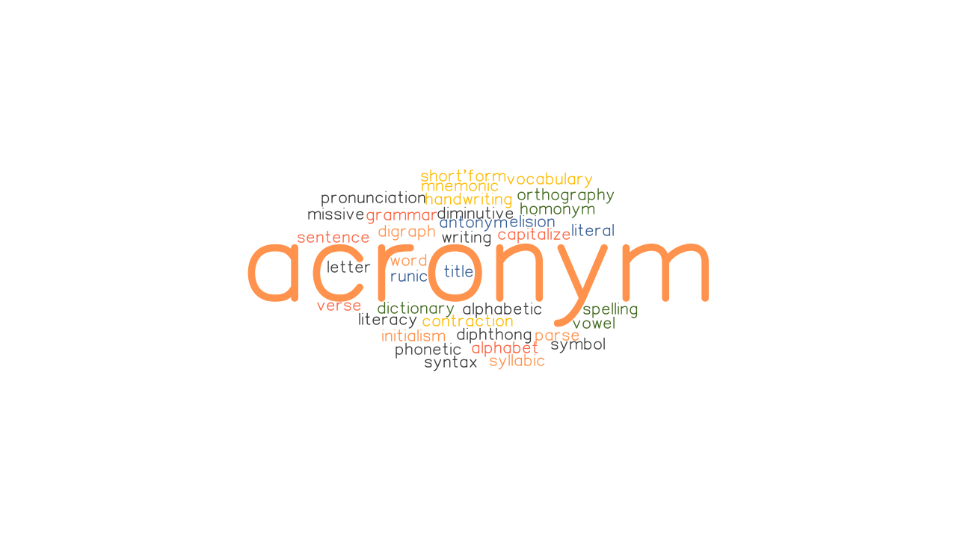
Acronym
MOCS | Mayor’s Office of Contract Services
PassPort System | Procurement and Sourcing Solutions Portal
HHS | Accelerator Health & Human Services Solicitation
OMB | Office of Management and Budget
ACS | American Community Survey
PPB | Procurement Policy Board
COIB | City’s Conflict of Interest Board
EIN | Federal Employer Identification Number
DCLA | Department of Cultural Affairs
CDF | Cultural Development Fund

Slide 37
Jeri Mendelsohn – NonProfit Help Desk Facilitator
jeri@nphd.org

Slide 38
An Intro to Discretionary Funding
NonProfit HelpDesk

